Slide 1





Saurastra Das
C o n s u l t a n t s
Project Management Services
…………………….
Architecture
…………………….
Interior Design
…………………….
Landscape Design
1

Slide 2




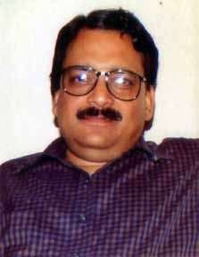


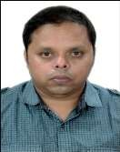
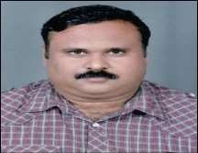
Our Or g a n i s a t i on
Established in the year 1984 by late Architect Saurastra Das, Netaji Indoor stadium at Cuttack and Raymond's Showroom at Bhubaneswar are his landmark projects, his untimely demise in a road accident in the year 1998, transferred the onus of completion of the continuing projects as his team and thus mission was carried by Architect Sagarendra Mohapatra and Architect Sabyasachi Mohanty and in due process M/s Saurastra Das Consultants has emerged as a leading Architectural firm in Bhubaneswar with many notable projects under its belt.
Late. Ar. Saurastra Ranjan Das
Ar. Sagarendra
Mohapatra
Ar. Sabyasachi
Mohanty
2

Slide 3

Our Ins p i r a t i on
With the passing of the ages empires are created and destroyed, new cultures appear and then again fade, like changing seasons into the shadows of eternity.
Vanishing into oblivion, all that remains of those that were once great and powerful in this world are but a handful of relics. Time, the destroyer of all things, vanquishes even the most invincible empires leaving behind their remnants to be marveled at by
future civilizations.
And marvel we do at the wonders of the past, especially the architectural wonders. Be it the pyramids of Egypt, the cathedrals of Rome, the Parthenon of Athens, the Forbidden City in Beijing, or Stonehenge, our mind is at once awed by the beauty and grandeur of ancient architecture.
3

Slide 4



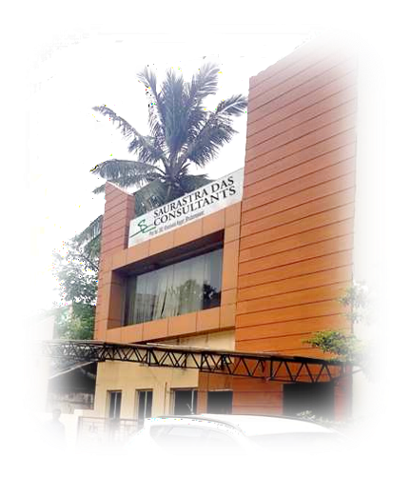
O u r S e r v i c e s
We believe in providing complete and comprehensive solution/ design which covers 360 degree.
The services include :-
Architectural Design
Interior Design
Landscape and Environmental design
PH Layout and Design
Electrical Layout and Design
Urban Design
Air Conditioning
Fire fighting
Techno Economic Feasibility report
Project management
We provide PMC services and have a experienced and qualified team covering all aspects such as time, Quality, money management and with supervision. We have a government approved testing laboratory for maintaining quality control during construction.
We undertake the following types of projects
- Housing - Commercial Complexes
- Educational Institutions - Office Buildings
- Healthcare Facilities - Recreational and Cultural Complexes
- Hotels and Resorts - Urban Design
- Industrial Complexes
4

Slide 6

OUR COMPLETED PROJECTS
6

Slide 7
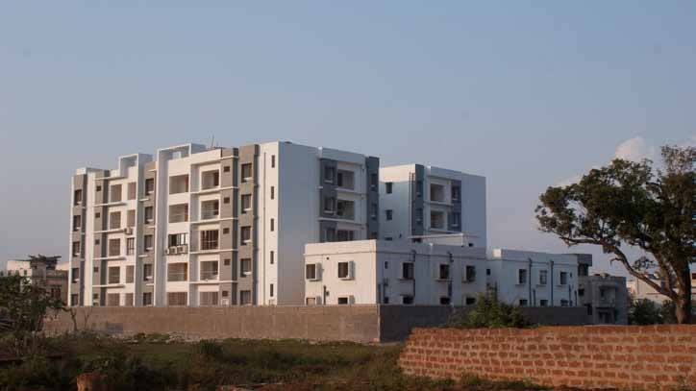
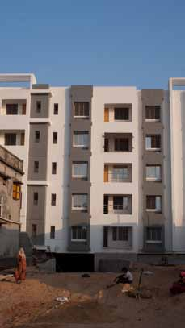
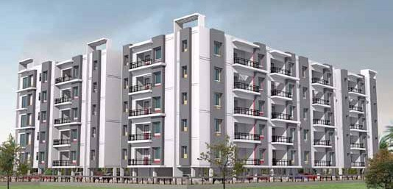
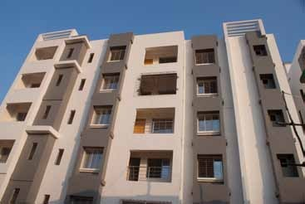
Project Location Client
Residential Aprartment Damana
Sree Jaganath Construction Pvt.Ltd
7

Slide 8
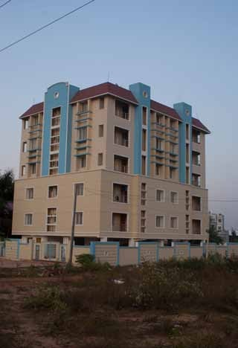
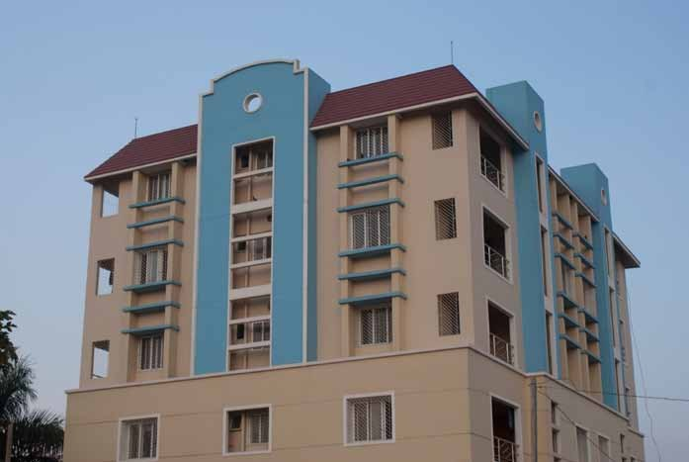
Project Location Client
Residential Aprartment Chandrasekharpur
Sree Jaganath Construction Pvt.Ltd
8

Slide 9
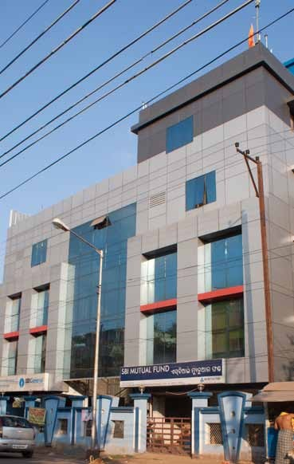
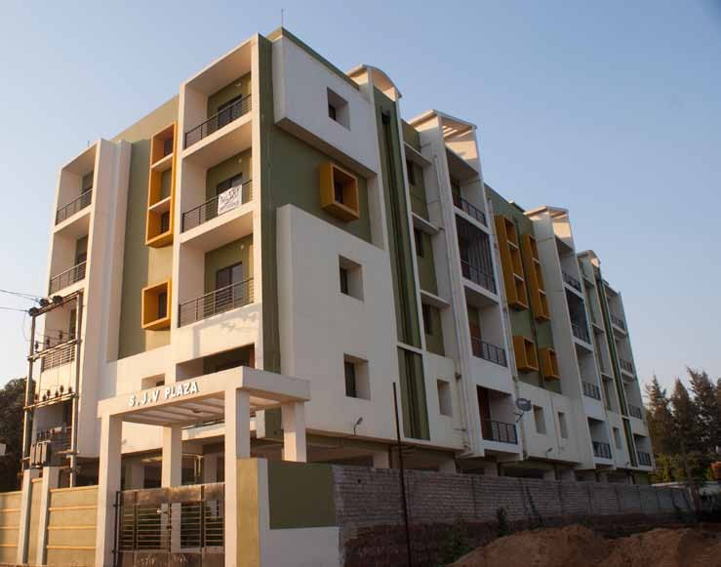
9

Slide 10
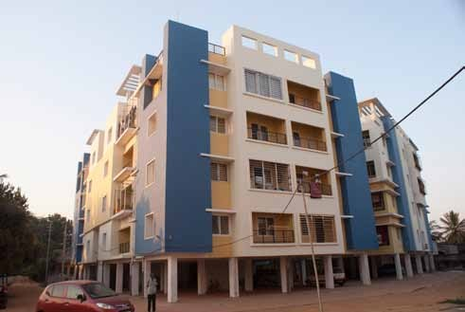
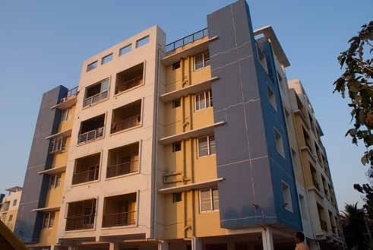
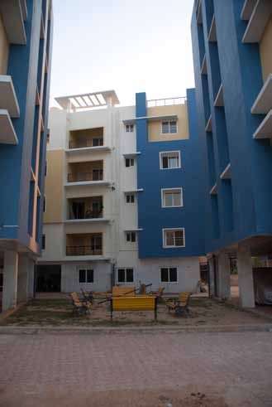
10

Slide 11
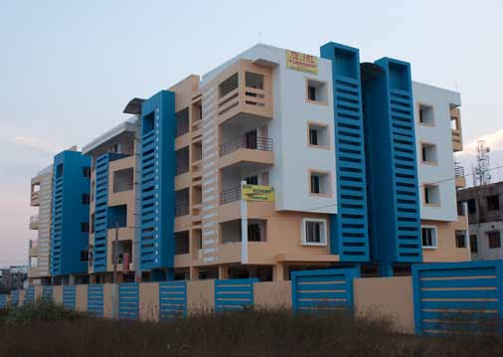
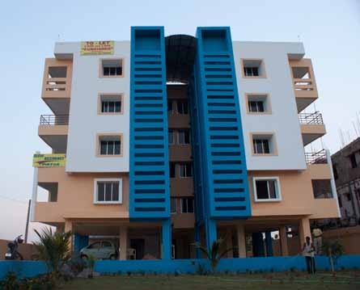
11

Slide 12
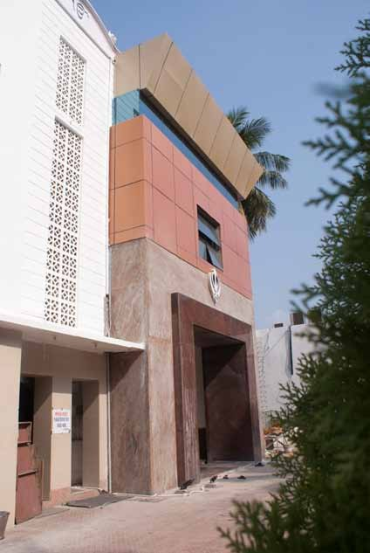
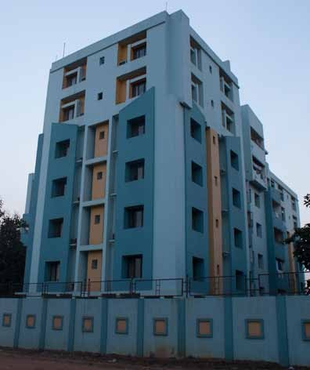
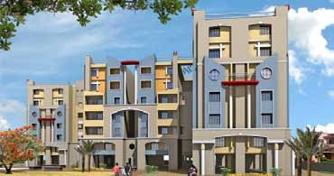
Project Location Client
Residential Aprartment Chandrasekharpur
RSM Infrastructures Pvt. Ltd.
12

Slide 13
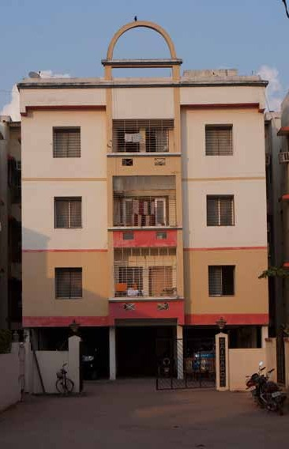
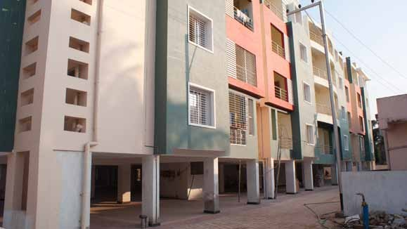

Slide 14
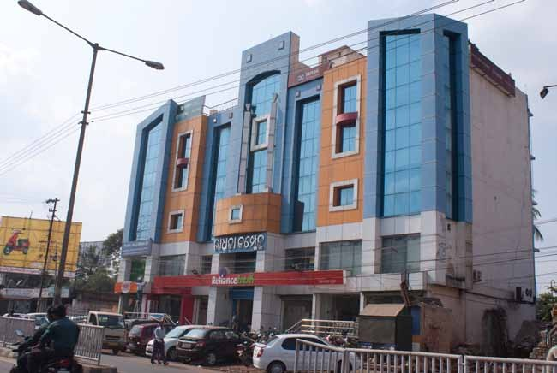
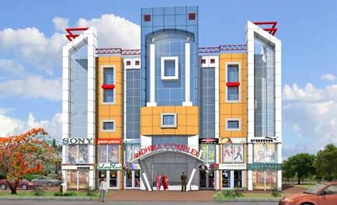
Project Location Client
Commercial Complex Jharpada
Sikhar Jena

Slide 15
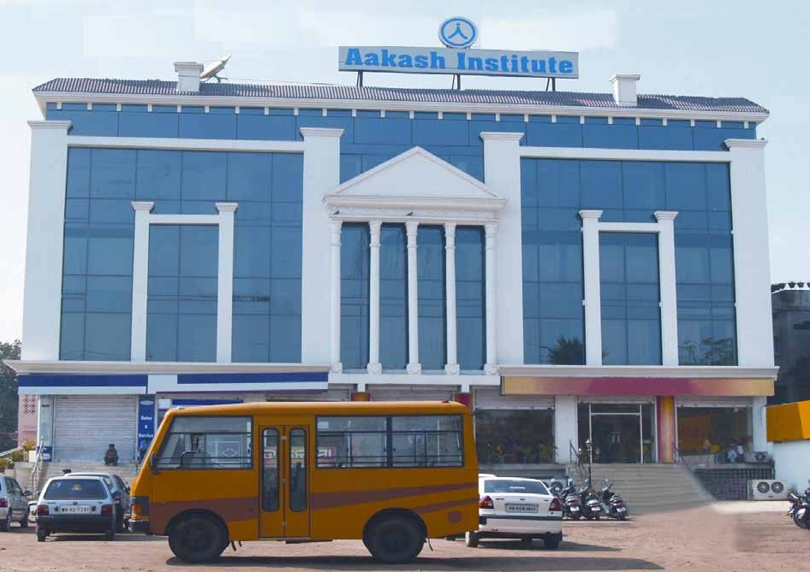
Project Location Client
Institutional Building Bhubaneswar Aakash Institute
15

Slide 16
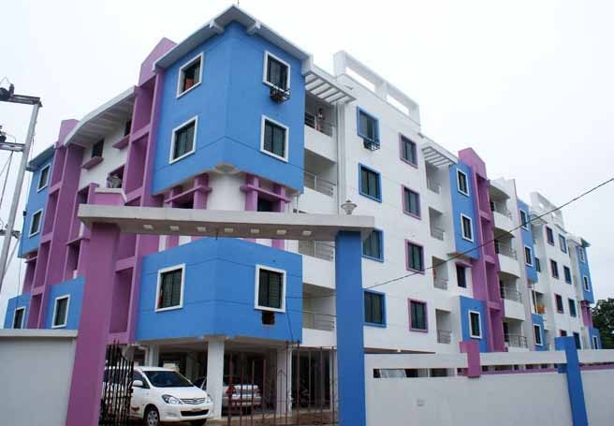
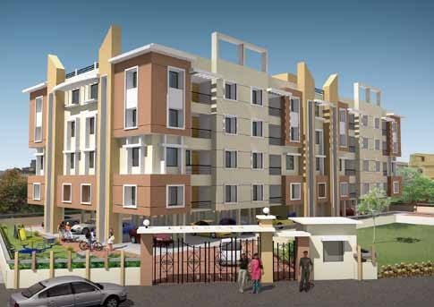
Project Location Client
Residential Apartment Rajarani Temple Bhavishya Homes Pvt. Ltd.
16

Slide 17
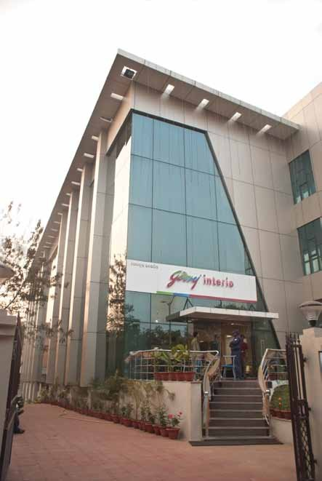
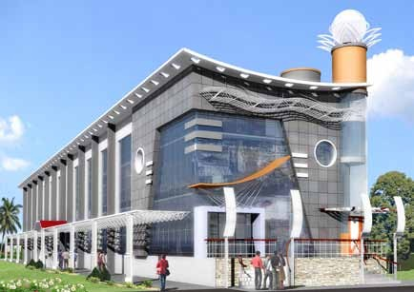
Project Location Client
Commercial Complex Lewis Road
Supratik Estates pvt.Ltd
17

Slide 18
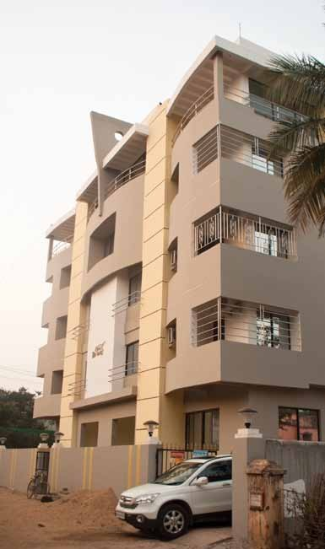
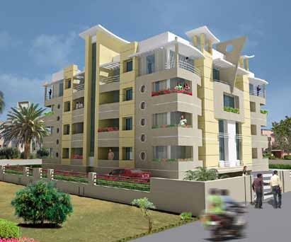
Project Location Client
Residential Apartment BJB Nagar
Supratik Estates pvt.Ltd
18

Slide 19
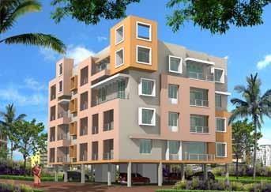
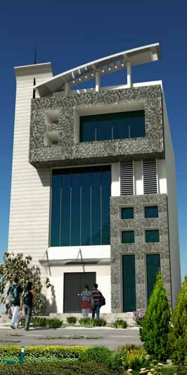
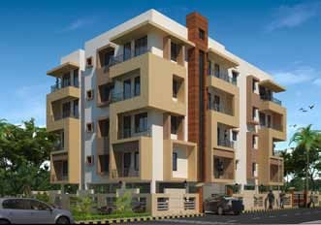
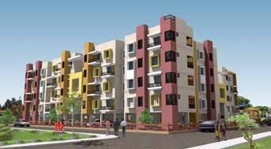
Project Location Client
Residential Apartment Patia
A.K.Developers
Project Location Client
Residential Apartment Patia
Ayush Infra Projects Pvt. Ltd
Project Location Client
Residential Apartment Kalarahanga
Akruti Developers
Project Location Client
Institutional Building Ranchi
Aakash Institute
19

Slide 20
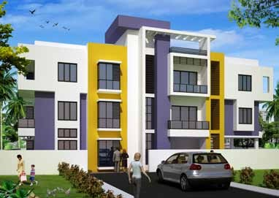
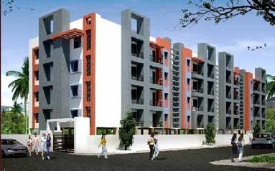
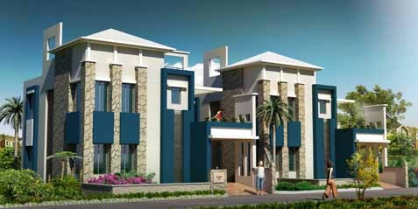
Project Location Client
Residential Apartment Patia
Ayush Infra Projects Pvt. Ltd
Project Location Client
Residential Apartment Patia
Ayush Infra Projects Pvt. Ltd
Project Location Client
Residential Duplex Jagasara
Combat Builders
20

Slide 21
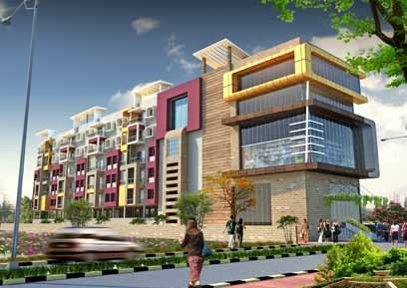
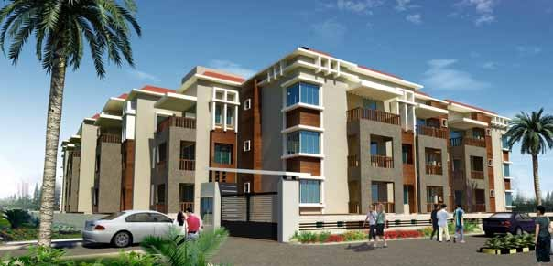
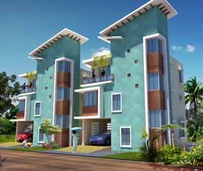
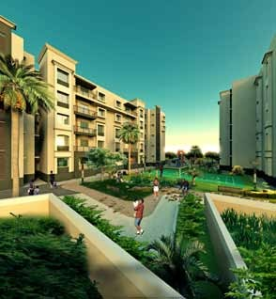
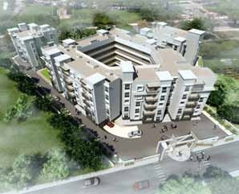
Project Location Client
Commercial Complex Patia
Basera Designs Pvt. Ltd.
Project Location Client
Residential Aoartment Bomikhal
Basera Designs Pvt. Ltd.
Project Location Client
Duplex Saheed Nagar
Basera Designs Pvt. Ltd.
Project Location Client
Residential Aoartment Patia
Basera Designs Pvt. Ltd.
23

Slide 22
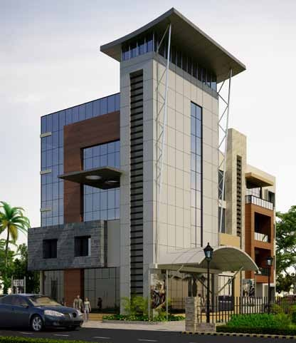
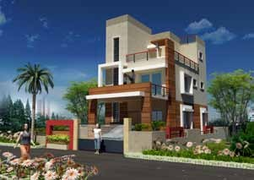
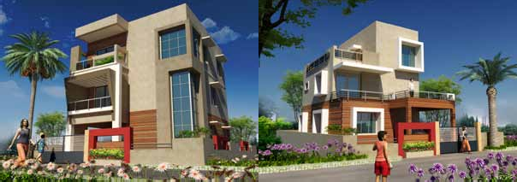
Project Location Client
Commercial Complex Bomikhal
Bibhu bhuyan
Project Location Client
Triplex Jharpada
Basera Designs Pvt. Ltd.
22

Slide 23
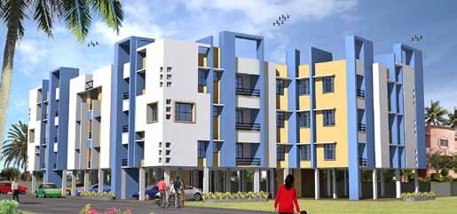
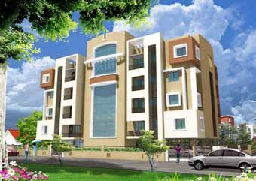
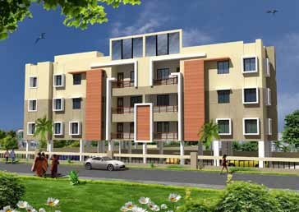
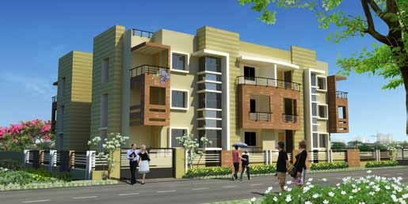
Project Location Client
Residential Apartment Chadrasekharpur
Builders Constium Pvt. Ltd.
Project Location Client
Residential Apartment Bharatpur
CZAR
Project Location Client
Residential Apartment Bomikhal
Crown Developers & Promoters
Project Location Client
Residential Apartment Shampur
Crown Developers & Promoters
27

Slide 24



Project Location Client
Residential Apartment Bomikhal
Bhavishya Homes Pvt. Ltd.
Project Location Client
Residential Apartment Lingipur
Bhavishya Homes Pvt. Ltd.
Project Location Client
Residential Apartment Ghatikia
Bhavishya Homes Pvt. Ltd.
24

Slide 25



Project Location Client
Residential Apartment Dumuduma
Mahadev Griha Nirman pvt. Ltd.
Project Location Client
Residential Apartment Dumuduma
Mason Estates pvt. Ltd.
Project Location Client
Residential Apartment Surya Nagar
Titan Das
30

Slide 26




Project Location Client
Hotel
Ashok Nagar Prasanta Satapathy
Project Location Client
Residential Aprartment Gadakana
Mr Bibhas Mohapatra
Project Location Client
Residential Aprartment Jayadev Vihar
Mr deepak Poddar
Project Location Client
Residential Aprartment Jagamara
Mr Mihir behera

Slide 27




Project Location Client
green chilly restaurant unit -1 market
Green Chilli Group
Project Location Client
Residential Apartment Jadupur
Kesari estates pvt. ltd.
Project Location Client
Residential Apartment Jadupur
Kesari estates pvt. ltd.
Project Location Client
Residential Apartment Jadupur
Kesari estates pvt. ltd.
29

Slide 28





Project Location Client
Private Residence Kalarahanga
Mr Chittaranjan
Project Location Client
Private Residence Ghatikia
Mr Jagannath Pattnaik
Project Location Client
Private Residence Tamando
Dr. Murti
Project Location Client
Private Residence Tamando P.K.Mishra
Project Location Client
Private Residence GGP Colony Parmit Samal

Slide 29





Project Location Client
Private Residence Tamando
Mr Pratap Jena
Project Location Client
Private Residence
Project Location Client
Private Residence Tamando
Mr Santosh parida
MrSanjeeb Sahoo
Project Location Client
Residential Aprartment
Project Location Client
Residential Aprartment
Mr Sanjay Chudiwala
Mr Sanjay Chudiwala

Slide 30




Project Location Client
Residential Apartment Ph -1 Bhagabanpur
Dream Multiple Projects
Project Location Client
Residential Apartment Ph -2 Bhagabanpur
Dream Multiple Projects
Project Location Client
Duplex Jagamara Palgroup
Project Location Client
Residential Apartment Paikanagar Durgamani Hota
28

Slide 31





Project Location Client
Residential Aprartment Haridaspur
Sagar Developers
Project Location Client
Residential Aprartment Gadakana
Sai Sree Pasupati Encon Pvt. Ltd
Project Location Client
Residential Aprartment Chadrasekharpur
Sai-Smruti Construction Pvt. Ltd
35

Slide 32




Project Location Client
Residential Aprartment Raghunathpur
Sanjay Tripathy
Project Location Client
Residential Aprartment Naharkanta
Sakti Builders
Project Location Client
Residential Duplex Khandagiri
Sanjay Tripathy
36

Slide 33




Project Location Client
Residential Aprartment Patia
Sree Hari Construction Pvt. Ltd
Project Location Client
Residential Aprartment Suryanagar
Sree Hari Construction Pvt. Ltd
Project Location Client
Residential Aprartment Patia
Sree Hari Construction Pvt. Ltd
Project Location Client
Residential Aprartment
Srusti-Builtcorn

Slide 34




Project Location Client
Residential Aprartment Pathargadia
Sanjay Pratap
Project Location Client
Residence
Project Location Client
Residential Aprartment Tamando
Serbadi Infrastrcture Pvt.Ltd
Sanjay Pratap

Slide 35




Project Location Client
Residential Aprartment Govind Prasad
Sree Jaganath Construction Pvt.Ltd
Project Location Client
Private Residence
Project Location Client
Residential Aprartment Patia
Sree Jaganath Construction Pvt.Ltd
Project Location Client
Residential Aprartment Gajapati Nagar
Sree Jaganath Construction Pvt.Ltd
Mr. Nihar

Slide 36



Project Location Client
Residential Aprartment Sailashreevihar
Sree Jaganath Construction Pvt.Ltd
Project Location Client
Residential Aprartment Sailashreevihar
Sree Jaganath Construction Pvt.Ltd
Project Location Client
Residential Aprartment Sailashreevihar
Sree Jaganath Construction Pvt.Ltd

Slide 37



Project Location Client
Residential Aprartment Sanapalla
Sudarshan Eastcon Pvt. Ltd
Project Location Client
Commercial Complex Sanapalla
Sudarshan Eastcon Pvt. Ltd

Slide 38



Project Location Client
Residential Aprartment Chandrasekharpur
Mr Titan Das
Project Location Client
Residential Aprartment Saheed Nagar
Mr Sidhart Biswal
Project Location Client
Residential Duplex Angul
Mr S. Agarwal

Slide 39





Project Location Client
Residential Apartment Patia
Tushar malik
Project Location Client
Residential Apartment Patia
Tushar malik
Project Location Client
Residential Apartment Bomokhal
Zilion Developers
Project Location Client
Residential Apartment Patrapada
Zilion Developers
Project Location Client
Residential Apartment Patrapada
Zilion Developers

Slide 40





Project Location Client
Residential Apartment Chandaka
Trishakti Promoters & Builders

Slide 41





Project Location Client
Residential Apartment Alarpur
Trishakti Builders & Developers
Project Location Client
Residential Apartment Bomikhal
Trishakti Builders & Developers
Project Location Client
Residential Apartment Bomikhal
Trishakti Builders & Developers

Slide 42



Project Location Client
Residential Aprartment GGP Colony
Sree Jaganath Construction Pvt.Ltd
Project Location Client
Commercial Apartment Saheed Nagar
Sree Jaganath Construction Pvt.Ltd
Project Location Client
Residential Aprartment Acharya vihar
Sree Jaganath Construction Pvt.Ltd

Slide 43


Project Location Client
Residential Apartment Jagamara
Trishakti Builders & Developers
Project Location Client
Residential Apartment Laxmisagar
Trishakti Builders & Developers

Slide 44



Project Location Client
Township at Balasore Andharua
Supratik Estates pvt.Ltd
Project Location Client
Duplex Andharua
Supratik Estates pvt.Ltd
47

Slide 45




Project Location Client
Township at Balasore (Duplex) Andharua
Supratik Estates pvt.Ltd
Project Location Client
Residential Apartment Jagamara
Supratik Estates pvt.Ltd
Project Location Client
Duplex Gothapatna
Supratik Estates pvt.Ltd
Project Location Client
Duplex Paikrapur
Supratik Estates pvt.Ltd
48

Slide 46



Project Location Client
Residential Apartment Gothapatna
Supratik Estates pvt.Ltd
Project Location Client
Residential Apartment Gothapatna
Supratik Estates pvt.Ltd
49

Slide 47




Project Location Client
Sitanath Residency Apartment Patia ,Near Koel Campus
Maa Khanduaali Developers PVT. LTD.

Slide 48



Project Location
Client
Khetrabashi Residency & K Plaza Patia .
Srihari Construction.
Project Location
Client
Commercial
Bamokhal.
Sahu Signature

Slide 49




Project Location
Client
Residential Apartment Kalarahanga.
Aastik Infra Project PVT.LTD
Project Location
Client
Residential Apartment Baramunda.
A_K_Developer
Project
Commercial cum
Residential Apartment
Gandhi Ghat , Puri .
Green Square PVT. LTD.
Project Location
Client
Residential Apartment Saileshree Vihar, BBSR.
Specific Infra Projects
Location Client

Slide 50




Project Location Client
D.H Bunglow OCL. Tangi, CTC. OCL India Ltd.
Project Location Client
Combo Tower Main Gate
OCL. Tangi, CTC .
OCL India Ltd.
Project Location Client
Multi-Purpose Hall OCL. Tangi , CTC.
OCL India Ltd.
Project Location
Client
CCR Building OCL,Rajgangpur.
OCL India Ltd.

Slide 51





Project
Location
Client
CCR Building
OCL. Tangi, CTC .
OCL India Ltd.
Project
Location
Client
Landscape
OCL. Tangi , CTC.
OCL India Ltd.

Slide 52






Project
Location
Client
Landscape
OCL. Tangi , CTC.
OCL India Ltd.

Slide 53



Project
Location
Client
Residential Apartment
Ghatikia, BBSR
Shree Jagannath Constructions
Project
Location
Client
Clinic cum Residential
Bhagabanpur, BBSR
Dr. Radhakanta Panigrahi
Project
Location
Client
Residential
Patia, BBSR
Prashant Tripathy

Slide 54




Project
Location
Client
Interior
Khandagiri, BBSR
Radhakrishna Mishra

Slide 55
OUR ONGOING PROJECTS
55

Slide 56




Project Location Client
Residentail Apartment Sijua
Basera Designs Pvt. Ltd.
56

Slide 57




Project Location Client
Residential
Chandrasekharpur
Ganesh Prasad Kar
Project Location Client
Residential Apartment Patrapada
Project Location Client
Residential Apartment
Sambalpur
Koshal Builders
Project Location Client
Commercial Complex
26
Jayaram lenka

Slide 58



Project Location Client
Residential
Kalinga Nagar, BBSR
Bibhabasu Das
Project Location Client
Commercial
Khordha
S S Ray
Project Location Client
Residential
Andilo, BBSR
Ronak Duggar
26

Slide 59



Project Location Client
Residential Apartment
Naya Bazaar, Cuttack
Mahadev Griha Nirman
26

Slide 60



Project Location Client
Residential Apartment
Satya Nagar, BBSR
Sanjiv Biswal
Project Location Client
Residential
Saheed Nagar, BBSR
Koshal Builders
Project Location Client
Residential Apartment
Saheed Nagar, BBSR
S J Developers
26

Slide 61

Project Location Client
Residential Complex
Nuahatta, Cuttack
Alishan Realcon Pvt Ltd
26

Slide 62

Project Location Client
Residential Complex
Nuahatta, Cuttack
Alishan Realcon Pvt Ltd
26

Slide 63



Project Location Client
Triplex
Kantabada, BBSR
Sai Harmony
Project Location Client
Residential Apartment
BJB Nagar, BBSR
Trishakti Promoters
26
Project Location Client
Residential Apartment
Dumduma, BBSR
Bhoomi Saranchana

Slide 64



Project Location Client
Bar & Restaurant Siripur
Project Location Client
Residential Apartment Dhada
BEBL
Project Location Client
Residential Aoartment Dhada
BEBL
Project Location Client
Residential Aoartment Dhada
BEBL
Project Location Client
Residential Aoartment Dhada
BEBL
22

Slide 65




Project Location Client
School
Jaipur, BBSR
Mo School
Project Location Client
Commercial cum Office
Angul
Angul Bus Terminal
Commercial Complex
Project Location Client
Residential Apartment
Sambalpur
Koshal Builders
Project Location Client
Residential cum Commercial
BJB Nagar, BBSR
Dream Multipurpose Project
26

Slide 66



Project Location Client
Residential Apartment
Patia
Titan Das
Project Location Client
Commercial cumResidential Malatipatapur
Techno Akruti Pvt. Ltd.
26

Slide 67


Project Location Client
Residential
Raghunathpur, BBSR
Fortune
26

Slide 68



Project Location Client
Residential
Ogalpada, BBSR
Trishakti Promoters
26

Slide 69




Project Location Client
Duplex Complex
Vivekananda Marg, BBSR
Narula Homes
26

Slide 70



Project Location Client
Residential Complex
Rudrapur, BBSR
Assotech Pride
26

Slide 71





Project Location Client
Residential Complex
Rudrapur, BBSR
Assotech Pride
26

Slide 72


Project :- Modern Bus Terminal Complex
Location :- NH-55, Angul, Odisha
Client :- Milan Developers

Slide 73




Project :- Modern Bus Terminal Complex
Location :- NH-55, Angul, Odisha
Client :- Milan Developers

Slide 74


Saurastra Das Consultants
THANK YOU
300, Karavel Nagar, Unit- III, Bhubaneswar - 751001
Tel : 0674 - 2392681

